Slide 1
Database Management System Unit-I
Mrs. Kanchan M. Bhale
VPKBIET, Baramati
kanchan.bhale@vpkbiet.org

Slide 2
Outline
What is Database?
Data Abstraction
Database Language
Database Models

Slide 3
What is database?
A collection of related pieces of data:
Representing/capturing the information about a real-world enterprise or part of an enterprise.
Collected and maintained to serve specific data management needs of the enterprise.
Activities of the enterprise are supported by the database and continually update the database.

Slide 4
An Example
UNIVERSITY DATABASE
Data about students, faculty, courses, research laboratories, course registration/enrollment etc.
Reflects the state of affairs of the academic aspects of the university.
Purpose: To keep an accurate track of the academic activities of the university.

Slide 5
Abstraction Levels
Set of Views
Set of Relations
Set of Files/index files

Slide 6
Data Abstraction
Data abstraction generally refers to the suppression of details of data organization and storage, and the highlighting of the essential features for an improved understanding of data
Physical level: describes how a record (e.g., instructor) is stored.
Logical level: describes data stored in database, and the relationships among the data.
type instructor = record
ID : string; name : string; dept_name : string; salary : integer;
end;
View level: application programs hide details of data types. Views can also hide information (such as an employee’s salary) for security purposes.

Slide 7
Instances & Schema
Physical schema– the overall physical structure of the database
Logical Schema – the overall logical structure of the database
Example: The database consists of information about a set of customers and accounts in a bank and the relationship between them
Analogous to type information of a variable in a program
View Schema-- Design of database at view Level . There may be multiple schema at view level.
Instance – the actual content of the database at a particular point in time
Analogous to the value of a variable

Slide 8
Example: Schema and Instances
Schema
Roll No | Name | DOB | City
String | String | Date | String
Student
Roll No | Name | DOB | City
20120001 | Akash Dhumal | 02/04/1997 | Pune
20120020 | Mrunal Dev | 05/06/1999 | Baramati
Instance

Slide 9
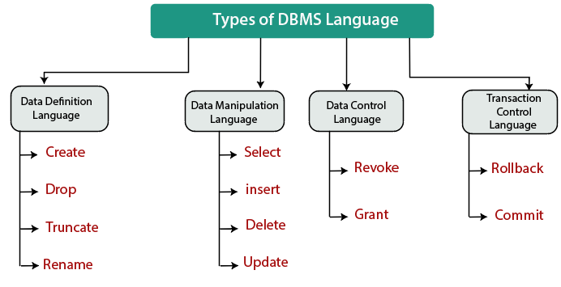
Database Languages

Slide 10
Data Definition Language (DDL)
Specification notation for defining the database schema
Example: create table instructor ( ID char(5), name varchar(20), dept_name varchar(20), salary numeric(8,2))
DDL compiler generates a set of table templates stored in a data dictionary
Data dictionary contains metadata (i.e., data about data)
Database schema
Integrity constraints
Primary key (ID uniquely identifies instructors)
Authorization
Who can access what

Slide 11
Data Manipulation Language
There are basically two types of data-manipulation language
Procedural DML -- require a user to specify what data are needed and how to get those data.
Declarative DML -- require a user to specify what data are needed without specifying how to get those data.
Declarative DMLs are usually easier to learn and use than are procedural DMLs.
Declarative DMLs are also referred to as non-procedural DMLs
The portion of a DML that involves information retrieval is called a query language.

Slide 12
SQL Query Language
SQL query language is nonprocedural. A query takes as input several tables (possibly only one) and always returns a single table.
Example to find all instructors in Comp. Sci. dept
select name from instructor where dept_name = 'Comp. Sci.'
Application programs generally access databases through one of
Language extensions to allow embedded SQL
Application program interface (e.g., ODBC/JDBC) which allow SQL queries to be sent to a database

Slide 13
Data Models
Data model—a collection of concepts that can be used to describe the structure of a database and provides the necessary means to achieve this abstraction.
A data model provides a way to describe the design of a database at the physical, logical, and view levels.

Slide 14
Data Models
Conceptual
Used for high level description and useful for requirements Understanding
Representational Describe logical representation of data
Physical
Giving Details about record formats , file structures

Slide 15
End of Lecture 2

